Slide 1
CENG3430 Rapid Prototyping of Digital Systems Lab02: First Program on ZedBoard

Slide 2
Setup for Zedboard

Slide 3
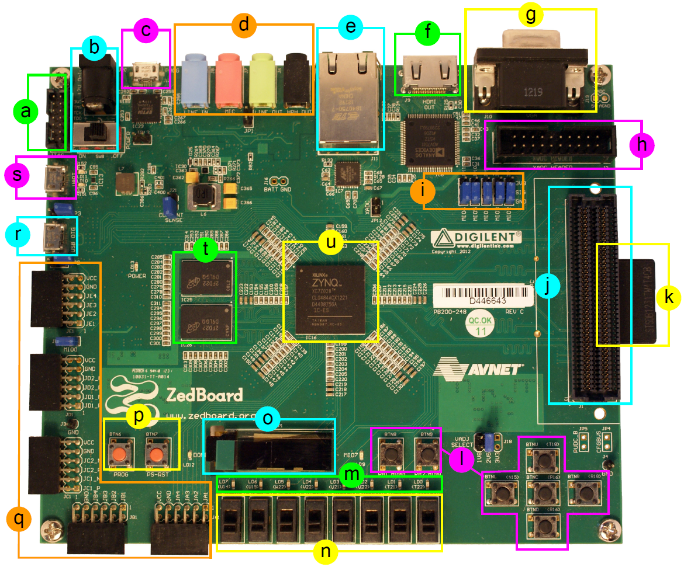
Our Board: Zynq ZedBoard
ZedBoard: Zynq Evaluation and Development Board

Slide 4
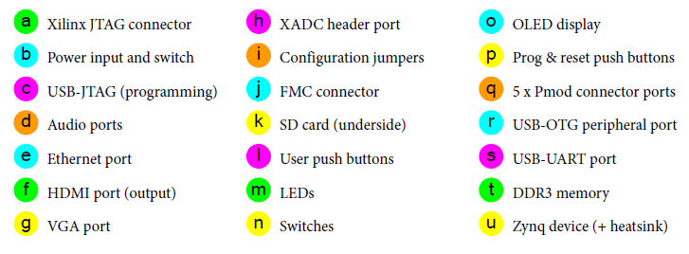
ZedBoard Layout and Interfaces
ZedBoard features a ZC7Z020 Zynq device.
Artix-7 logic fabric, with a capacity of 13,300 logic slices, 220 DSP48E1s, and 140 BlockRAMs
DDR3 Memory, and Flash
Several peripheral interfaces

Slide 5
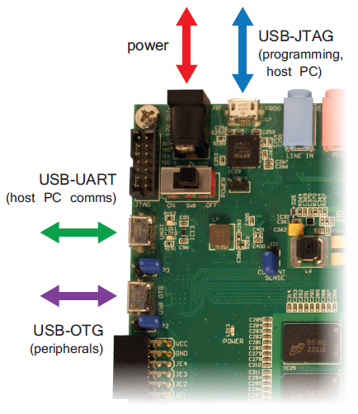
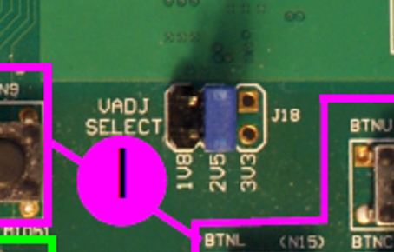
Hardware Setup for ZedBoard
The ZedBoard must be connected to a power supply.
By default, ZedBoard connects to the host PC for programming over USB-JTAG by micro-USB wire
Check the Vadj Select is 2V5 at the I area (Near the buttons)
Vadj Select (J18)

Slide 6
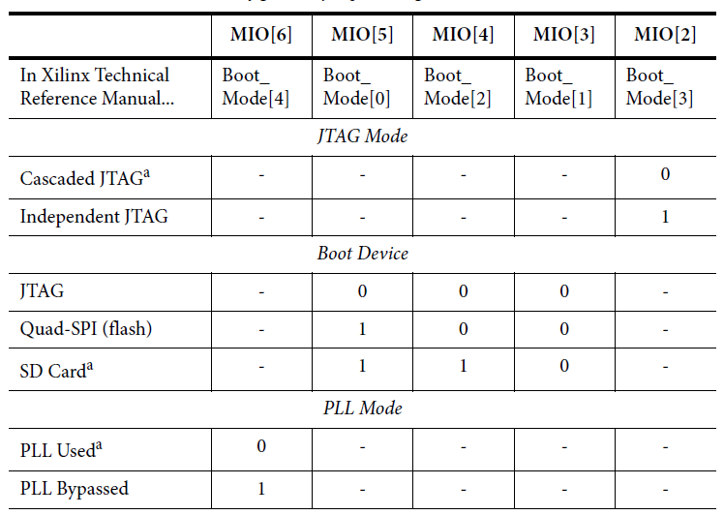
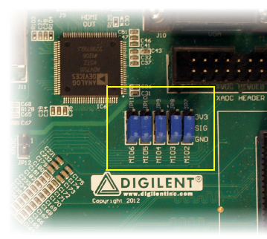
Programming the ZedBoard
The ZedBoard user specifies the method of booting / programming via a set of jumper pins.
The middle three are for specifying programming source.
Cascaded: A single JTAG connection is used to interface to the debug access ports in both the PS and PL.
Check!
The PLL mode determines whether the process of configuring the device includes a phase of waiting for the PLL to lock

Slide 7
Lab02 - 3-bit Full Adder

Slide 8
Lab02 – 3-bit Adder Design Flow
Task 1
Write a Full Adder VHDL code
Fill in the XDC file
Run on board and Debug
Task 2
Build a 3-bit Full Adder
(Reusing the Full Adder)
Fill in the XDC file
Run on board and Debug

Slide 9
Lab02 – Task 1

Slide 10
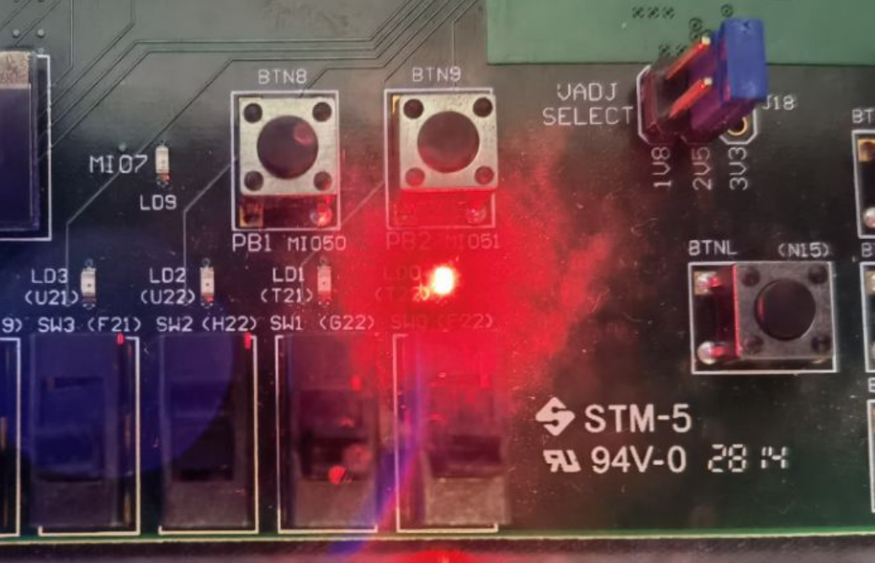
Procedures of each task
Procedures
Start the Vivado IDE and create a new project (see Lab01)
Remember to specify ZedBoard when creating a new project
Add a VHDL source file to your project (and implement)
Add constraints (i.e., an XDC file) to your project
Synthesis, implementation, and generate bitstream
Download/Program your design to ZedBoard
Verify your design on ZedBoard
Called “lab02”

Slide 11
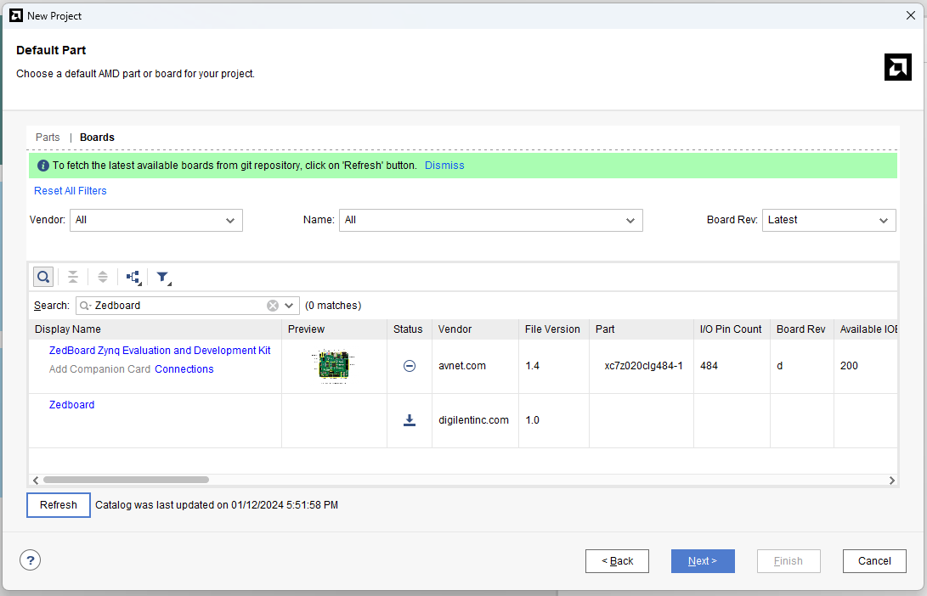
① Specifying ZedBoard in Vivado
ZedBoard Zynq Evaluation and Development Kit:
The design tools have knowledge of the specific facilities and peripheral connections of ZedBoard.
Refer to the appendix if ZedBoard is still not listed.

Slide 12
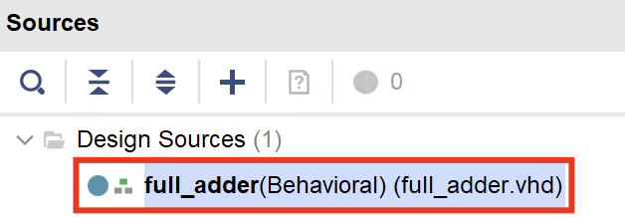
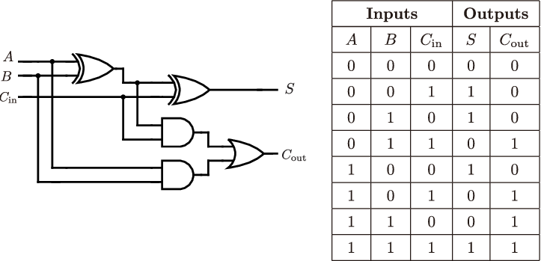
② Add a VHDL File and Implement
Create a design source called “full_adder”
Implement the Full Adder
Style 1: Logic gates only
Style 2: when-else + logic gates

Slide 13
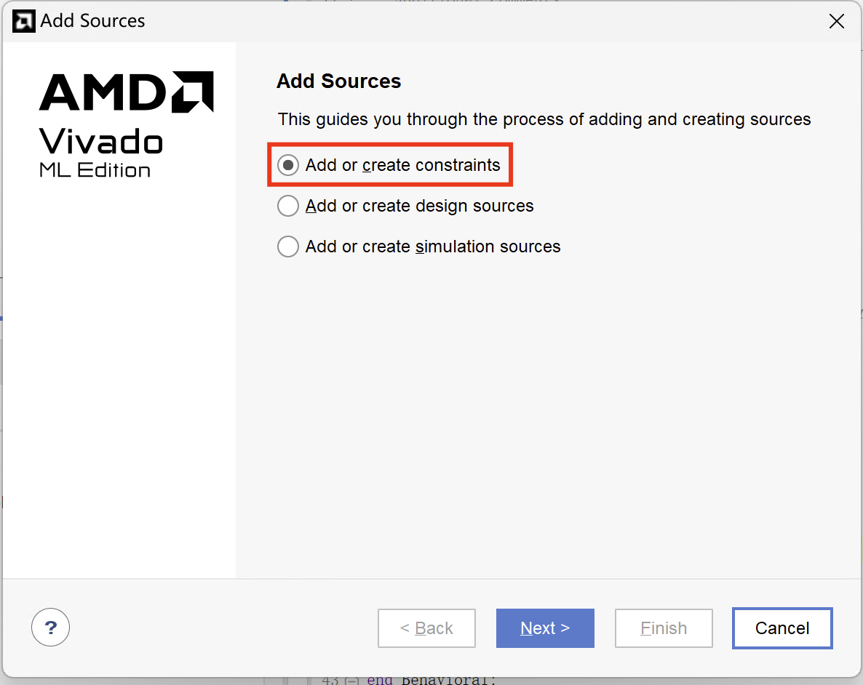
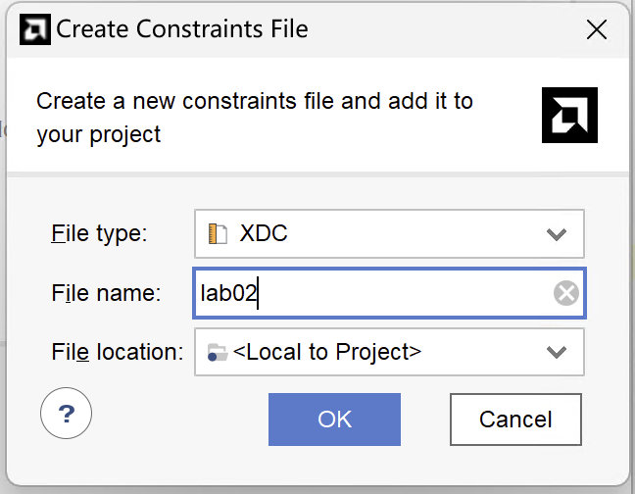
③ Create XDC File (1/2)
Right Click “File->Add Sources->Add or create constrain->Create File->OK”
Create a .xdc file called “lab02.xdc”
Enter file name
Press OK

Slide 14
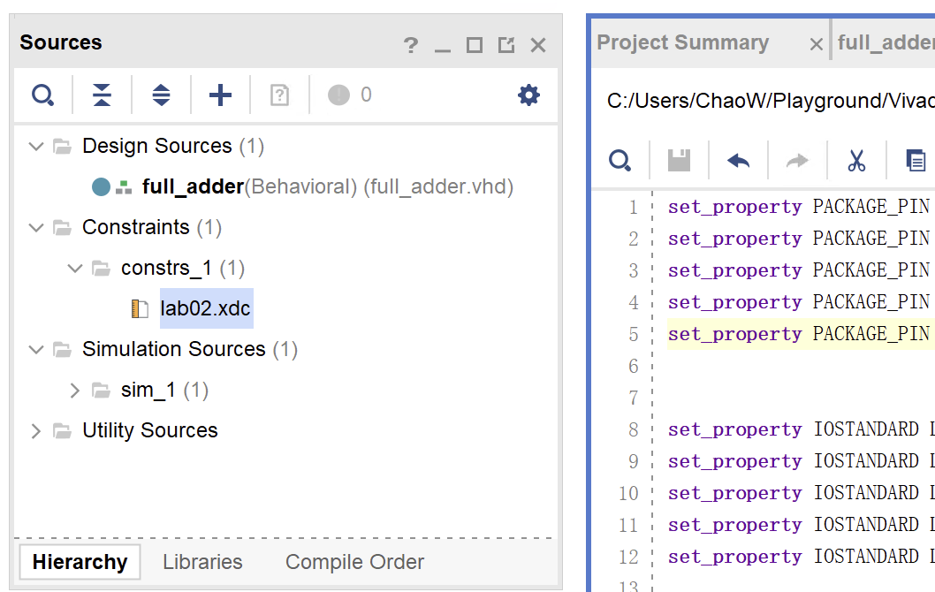
③ Create XDC File (2/2)
Double Click “lab02.xdc” file
Fill in the constrains with pin ID and voltage

Slide 15
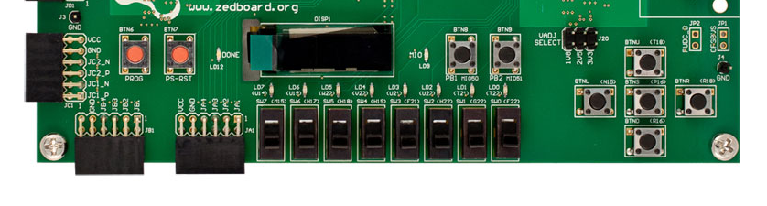
.xdc File Specification
Double Click “lab02.xdc” file
Fill in the constrains with pin ID and voltage
A → SW5
B → SW0
Cin → BTNC
Sum → LED0
Cout → LED1

Slide 16
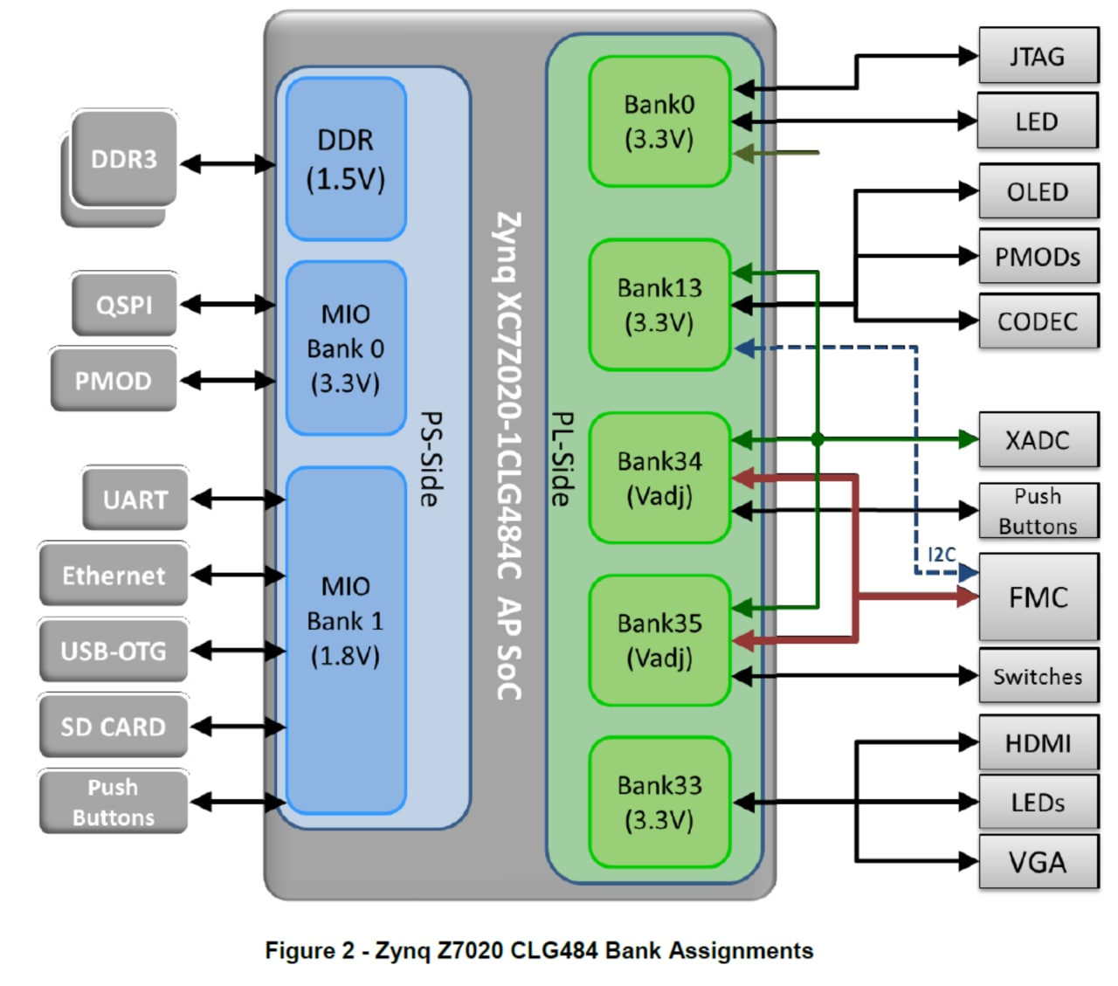
Board Specification
Recall the syntax
set_property PACKAGE_PIN T22 [get_ports {C}]; # "LD0"
set_property PACKAGE_PIN F22 [get_ports {A}]; # "SW0"
set_property PACKAGE_PIN G22 [get_ports {B}]; # "SW1"
set_property IOSTANDARD LVCMOS33 [get_ports C]; # "LD0“
set_property IOSTANDARD LVCMOS25 [get_ports A]; # “SW0“
set_property IOSTANDARD LVCMOS25 [get_ports B]; # “SW1“
AND gate example in the Lecture
Voltage Reference
(Details see Lec02)

Slide 17
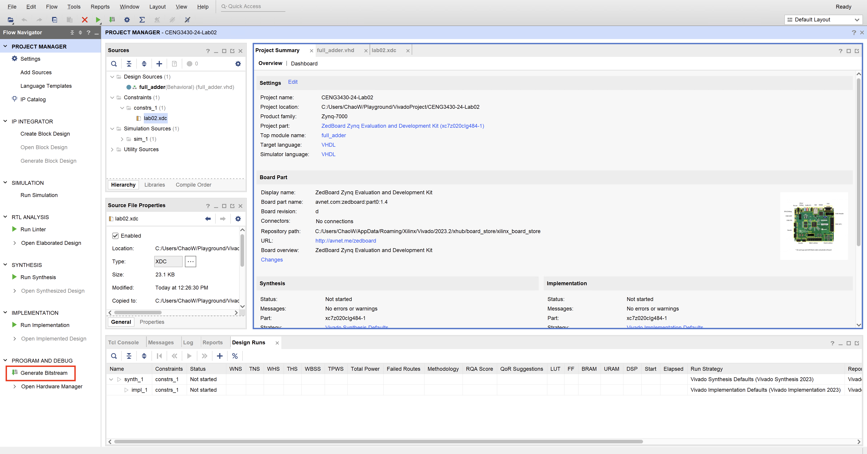
④ Synthesis, Implementation, Bitstream
Click “Generate Bitstream”
Automatically run Synthesis, Implementation, and Generate Bitstream in sequence

Slide 18
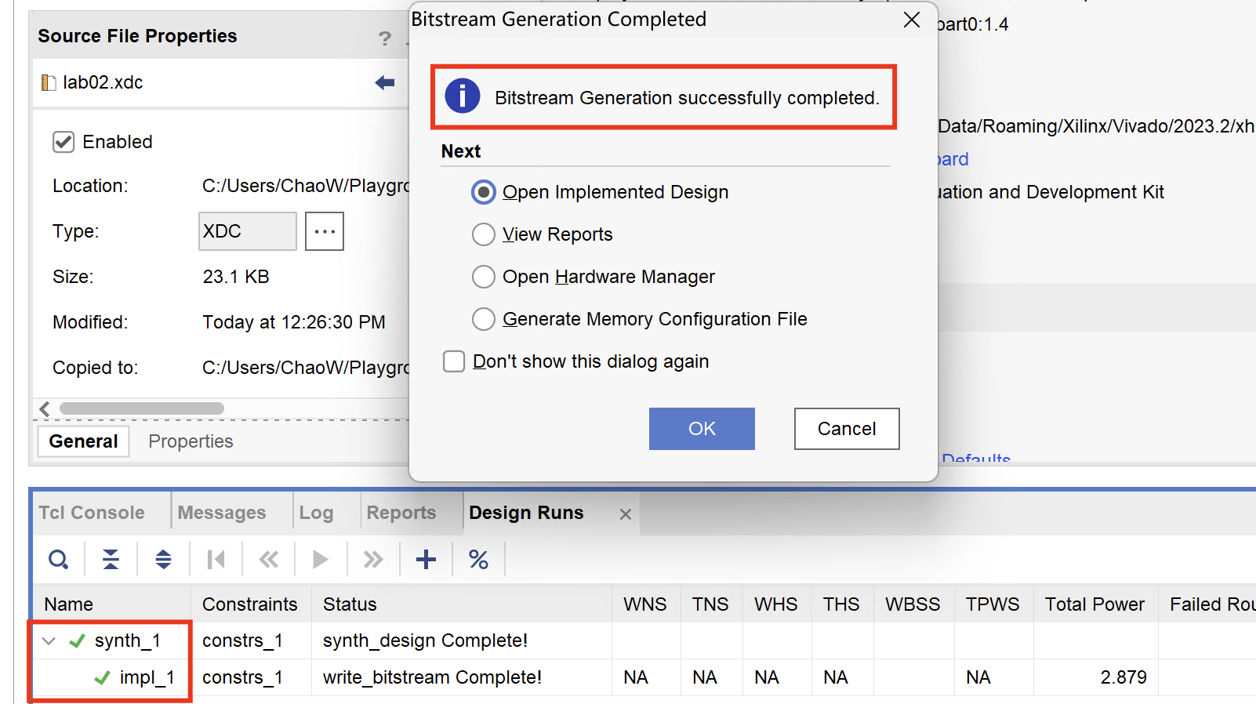
④ Synthesis, Implementation, Bitstream
If there is no error, then you will see the successful message as shown on the picture:

Slide 19
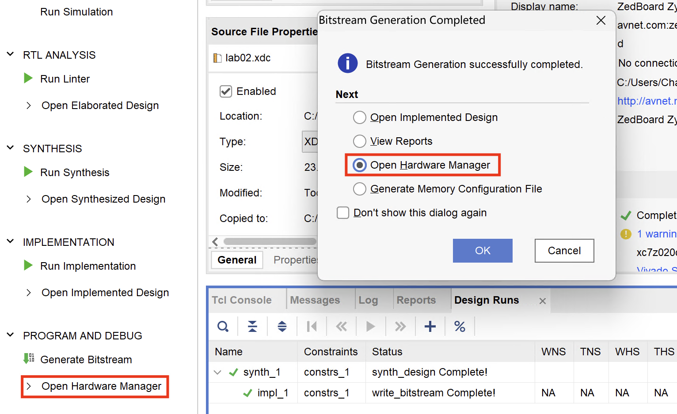
⑤ Download/Program Your Design
Click “Open Hardware Manager” -> “OK”
Make sure your FPGA is connected to PC

Slide 20
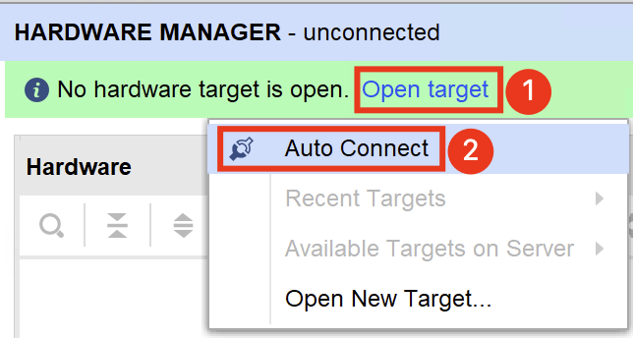
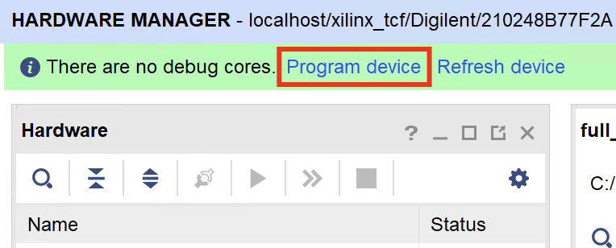
⑤ Download/Program Your Design
If Hardware Manager reports unconnected press Open target and select Auto Connect.
After the system successfully connected to the ZedBoard press Program device. Then press Program.
When the programming is successfully done the blue LED on the ZedBoard will turn on.

Slide 21
⑥ Verify Your Design on ZedBoard
Verify the design using SW0, SW5, BTNC

Slide 22
Lab02 – Task 2

Slide 23
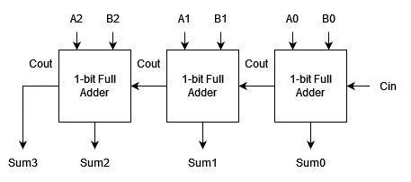
Task 2
Same design procedure as Task 1
Reusing the Full Adder to build a 3-bit Full Adder

Slide 24
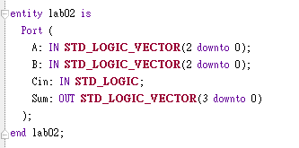
Step 1. Create a new design source
Create a new design source called “lab02”
The entity should be like this
Must use component and port map to implement the 3-bit Full Adder by reusing the Full Adder module
The syntax of specifying a bit in std_logic_vector is A(0)

Slide 25
.xdc File Specification
Double Click “lab02.xdc” file
Fill in the constrains with pin ID and voltage
A → SW5 - SW7 (A[0]: SW5, A[1]: SW6, …)
B → SW0 - SW2
Cin → BTNC
Sum → LED0 - LED3
Specifying a pin in std_logic_vector is A[0]

Slide 26
Demo Video Specification
Since 3-bit Full Adder has 128 test cases, we only require you to demonstrate 5 test cases through demo video
Each test case must present the result with AND without the Cin=‘1’
 | Input |  | Expected Output
Case | A | B | Cin=0 | Cin=1
1 | 000 | 001 | 0001 | 0010
2 | 011 | 101 | 1000 | 1001
3 | 101 | 111 | 1100 | 1101
4 | 010 | 010 | 0100 | 0101
5 | 110 | 001 | 0111 | 1000

Slide 27
Lab02: Submission File Checklist
Lab02.zip
lab02.vhd
full_addr.vhd
lab02.xdc
Demo Video
Clearly demonstrate the cases with LEDs, switches, and button
Under Project Folder → lab02.srcs
Submission Rule:
Submit the zip file following the above format to Blackboard
Deadline: 14:30 on 30 Jan. 2024
Late submission is NOT acceptable (unless otherwise approved)

Slide 28
Thank You!

Slide 29
Appendix
Is ZedBoard still not listed even after refreshing?
Plan A: utilize the script
Open the command prompt
Copy the following script to the command prompt.
Reopen Vivado, ZedBoard can be found.
REM set variables
SET https_proxy=proxy.cse.cuhk.edu.hk:8000
SET DOWNLOAD_URL=https://github.com/Digilent/vivado-boards/archive/master.zip
SET DOWNLOAD_PATH=C:\temp
SET UNZIP_PATH=C:\temp\
SET DEST_PATH=C:\Xilinx\Vivado\2023.2\data\boards\board_files
REM create folders
IF NOT EXIST %DOWNLOAD_PATH% (
mkdir %DOWNLOAD_PATH%
)
IF NOT EXIST %DEST_PATH% (
mkdir %DEST_PATH%
)
REM download board files
curl -Lk -o %DOWNLOAD_PATH%\master.zip %DOWNLOAD_URL%
REM unzip board files
IF EXIST %DOWNLOAD_PATH%\master.zip (
PowerShell -Command "Expand-Archive -Path '%DOWNLOAD_PATH%\master.zip' -DestinationPath '%UNZIP_PATH%'"
) REM copy board files into vivado
xcopy /E /Y %UNZIP_PATH%\vivado-boards-master\new\board_files %DEST_PATH%
REM remove temp files
IF EXIST %UNZIP_PATH% (
rmdir /S /Q %UNZIP_PATH%
) REM Success
Plan B: click here and follow the guide.

